Slide 1
UIT2201 – Programming and Data Structures
Binary Search Tree

Slide 2
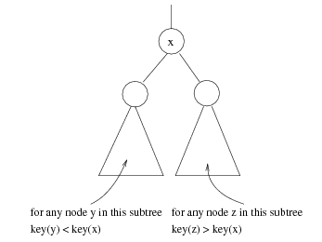
Binary Search Trees
Stores keys in the nodes in a way so that searching, insertion and deletion can be done efficiently.
Binary search tree property
For every node X, all the keys in its left subtree are smaller than the key value in X, and all the keys in its right subtree are larger than the key value in X

Slide 3
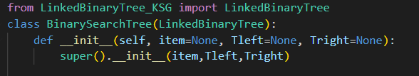
Binary Search Tree class

Slide 4
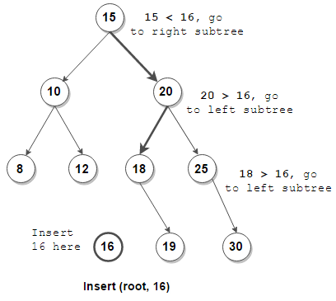
Binary Tree Insertion

Slide 5
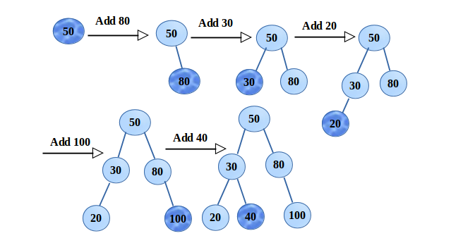
Binary Tree Insertion

Slide 6
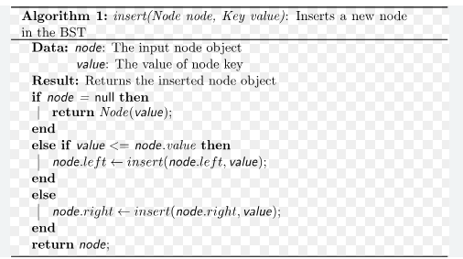
BST insertion

Slide 7
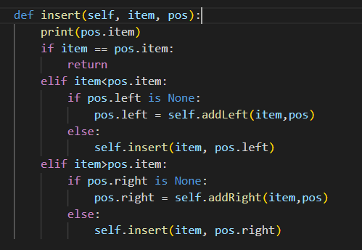
BST Insertion in Python

Slide 8
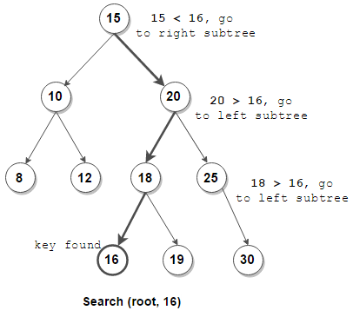
Search in BST

Slide 9
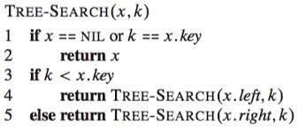
Search in BST

Slide 10
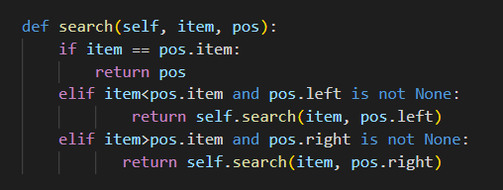
Search in BST in Python

Slide 11
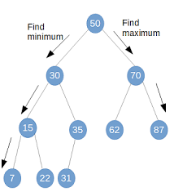
Findmax and Findmin in BST

Slide 12
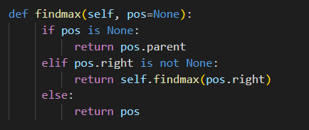
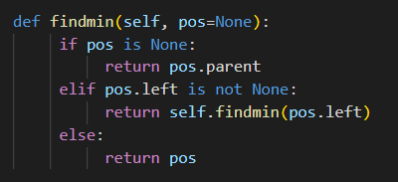
Findmax and Findmin in BST

Slide 13
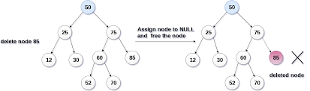
Deletion with no children

Slide 14
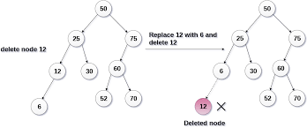
Delete node with one child

Slide 15
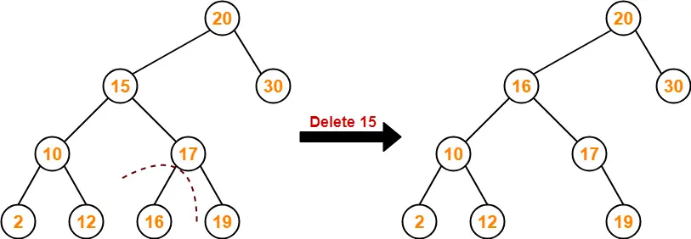
Delete node with two child

Slide 16
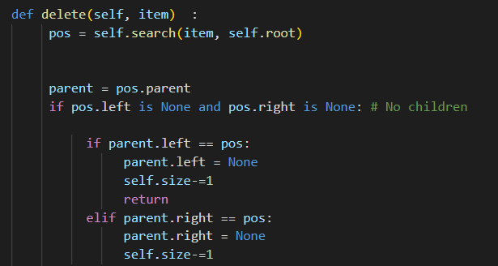
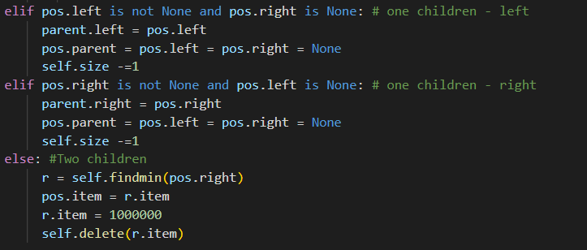
Delete in BST

Slide 17
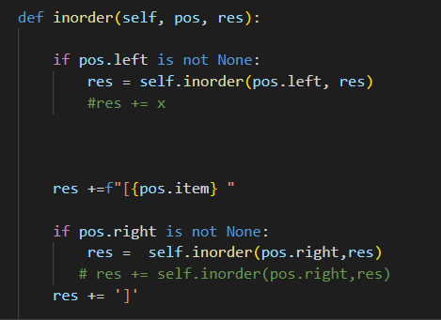
Inorder traversal – LinkedBinaryTree

Slide 18
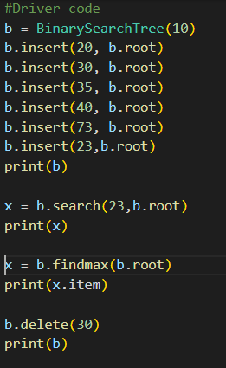

Driver code for Binary Search Tree
Output

